Slide 1
The Datapath

Slide 2
Datapath
The datapath carries out instructions via the fetch/execute cycle.
It is a grouping of elements such as the ALU, a Register File, and a bus.
Processes data and addresses

Slide 3
Goal
We will create a Datapath to implement a subset of MIPS instructions:
lw and sw
add, sub, and, or, slt (R-Types)
beq, j

Slide 4
Executing an Instruction
Send the program counter (PC) to the memory that contains the code and fetch the instruction from that memory
Read one or two registers, using fields of the instruction to select the registers to read. For the lw, we need to read only one register, but most others require two registers
… next step depends on the instruction class (what are the classes?)

Slide 5
Types of Datapath Elements
The following slides review the two types of elements in the datapath:
Unclocked Combinational
Clocked state

Slide 6
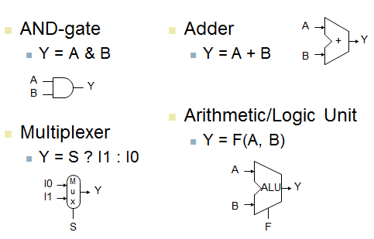
Combinational Elements

Slide 7
MIPS State Elements AKA Sequential Elements
Flip-Flops ● Memories ● Registers
At any given point, the collection of State Elements characterizes the machine.
If the contents of these elements is saved to disk and the machine loses power, we can reload the data and damage from power loss would be minimized.

Slide 8
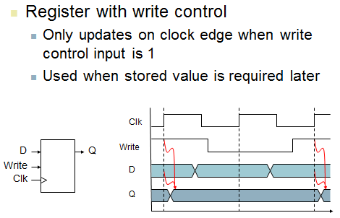
Sequential Elements

Slide 9
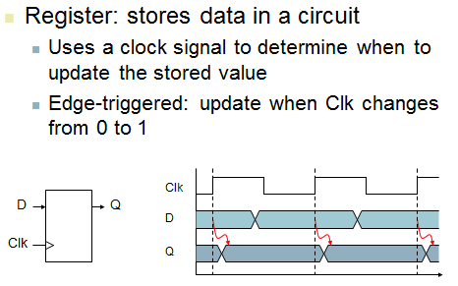
Sequential Elements

Slide 10
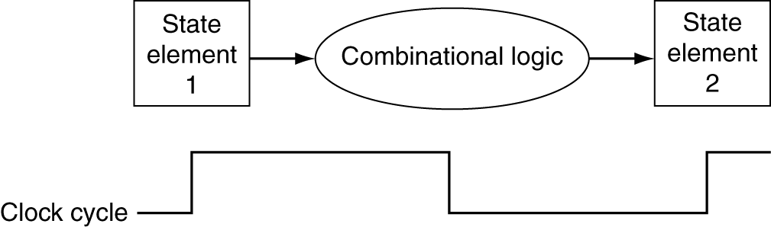
Clocking Methodology
Combinational logic transforms data during clock cycles
Between clock edges
Input from state elements, output to state element in order to store CL results
Longest delay determines clock period

Slide 11
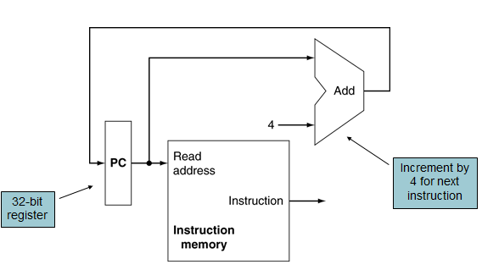
Instruction Fetch Datapath

Slide 12
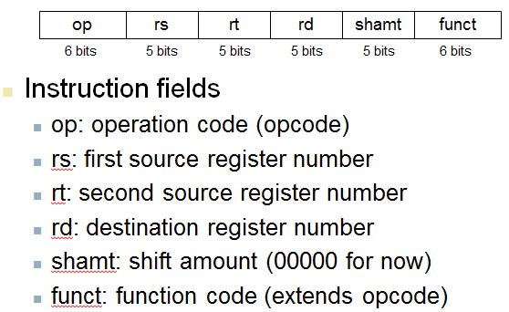
R-Format Instructions

Slide 13
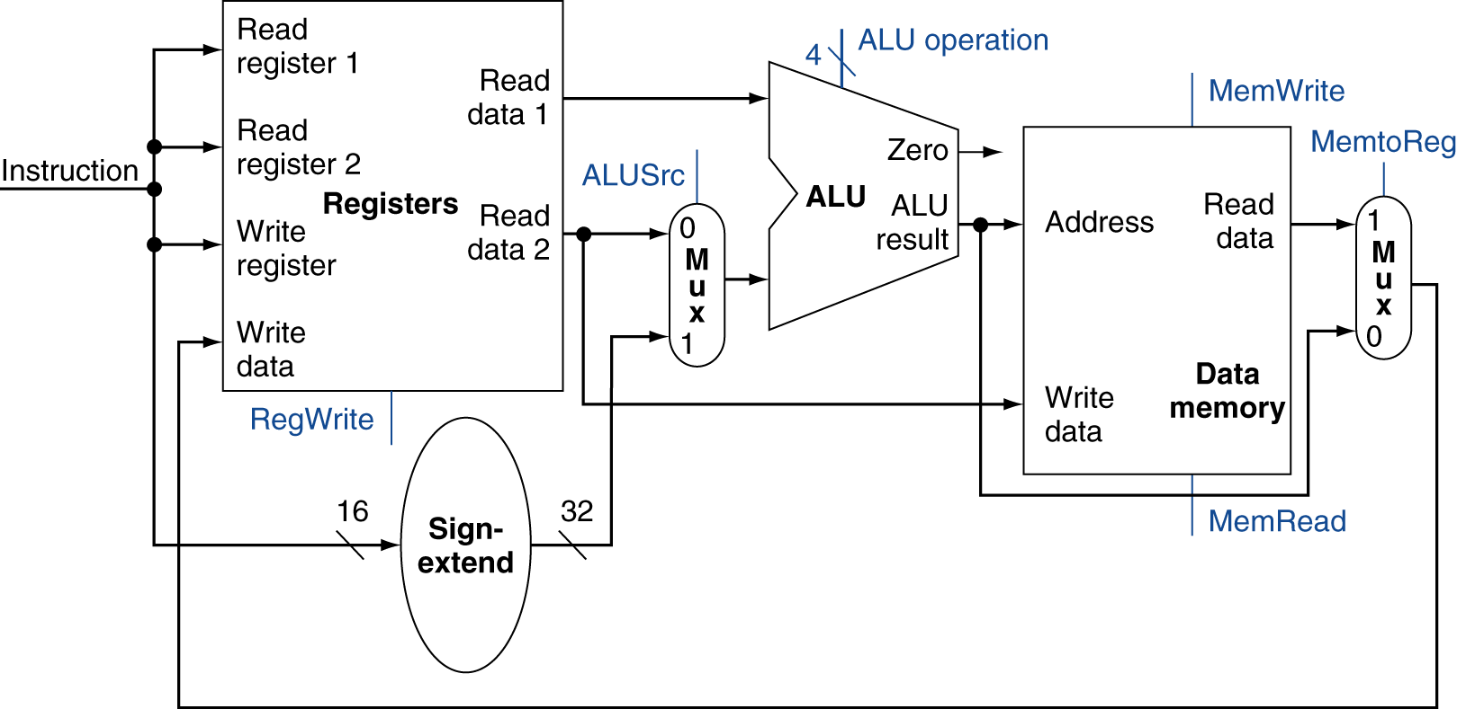
R-Type/Load/Store Datapath

Slide 14
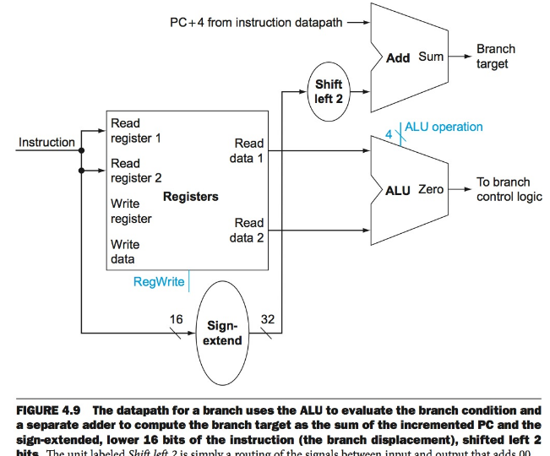
Branch Datapath

Slide 15
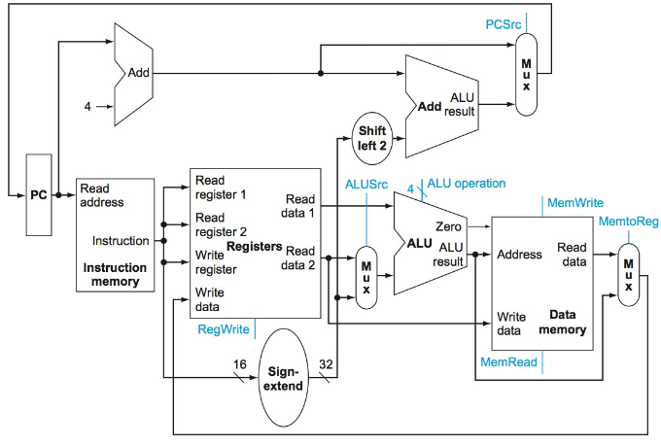
Full Datapath

Slide 16
Controlling the Datapath
We have the components and connections, but how do we get them to perform the proper functions depending on the instruction?
The “control” consists of the settings for components which tell it what to do.

Slide 17
Example: ALU control
Depending on the instruction, the ALU will carry out different operations:
For an “add” instruction …well, self explanatory…
But what for a blt? What does the ALU have to do?
SUBTRACT!

Slide 18
Example: ALU Control
Therefore, if you have an add instruction, you set the ALU to add.
If you have a blt instruction, you set the ALU to subtract. Here’s how….

Slide 19
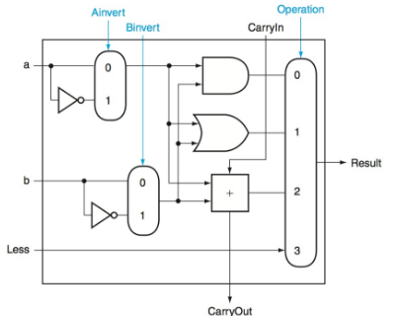
Applying Control to ALU
When an instruction is executed, the controls (indicated in blue) are set so that the ALU gives the appropriate result.

Slide 20
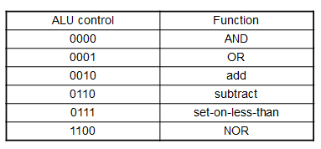
ALU Control
Here are the ALU control settings for…
Load/Store: add
Branch: subtract
R-type: depends on funct field
ALU control | Function
0000 | AND
0001 | OR
0010 | add
0110 | subtract
0111 | set-on-less-than
1100 | NOR

Slide 21
Determining ALU and other Control
The Datapath contains a piece of combinational logic called the Control Unit which takes the instruction as output and generates control for the components.
This control ensures the components carry out the proper tasks given the instruction.

Slide 22
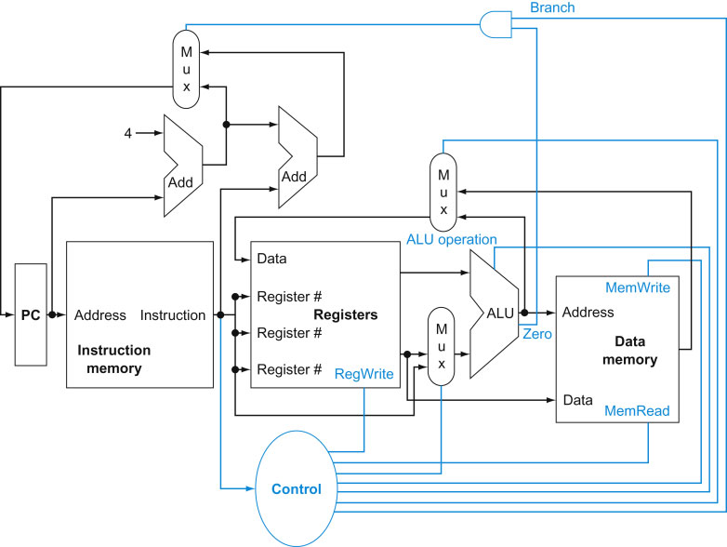
Datapath
Note that the instruction goes into the unclocked control unit. The control unit generates 7 lines

Slide 23
Control Unit: Generating ALU Control
How do we get from the instruction to the control?
How do we get anywhere in this class?
ALL HAIL THE TRUTH TABLE!

Slide 24
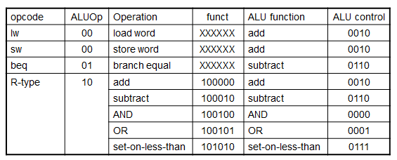
ALU Control
Assume 2-bit ALUOp derived from opcode
Combinational logic derives ALU control

Slide 25
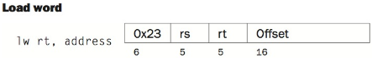
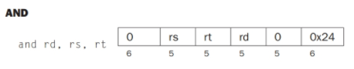
How is ALUOp determined?
Each Instruction has the “opcode” in the highest order bits.
This is a numeric representation of the instructions “operation”

Slide 26
How is ALUOp determined?
The Control Unit will map the op code of the instruction to one of the four possibilities:
00
01
10
How in the world do you think THIS happens?

Slide 27
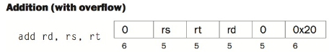
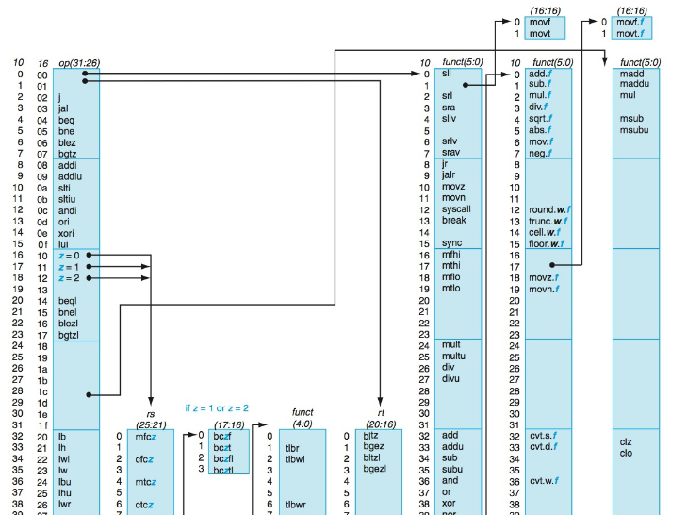

Slide 28
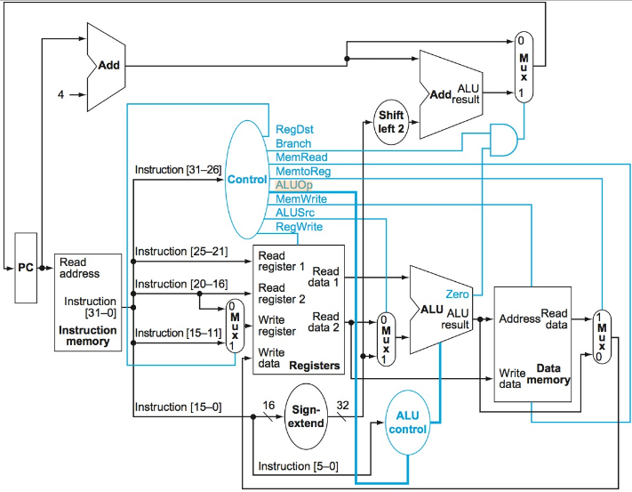
The Main Control Unit

Slide 29
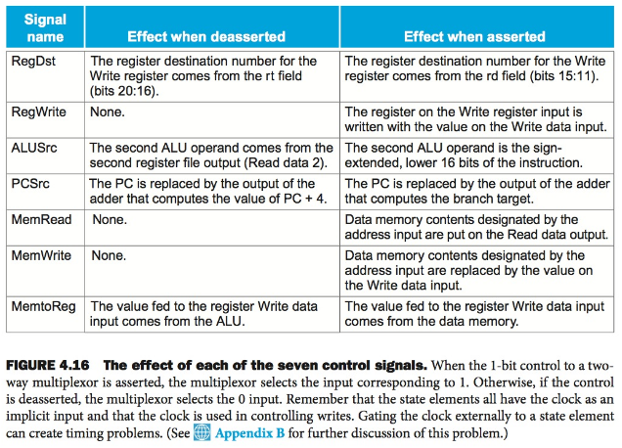
Significance of Control Lines

Slide 30
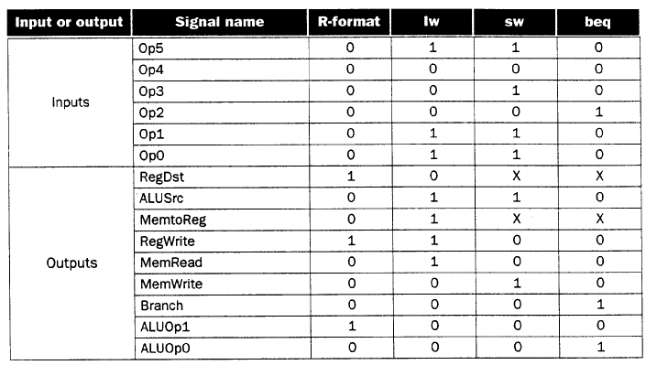
R-format = 0 = 000000
lw=0x32=100011
sw=0x2b=101011
be=0x4=000100

Slide 31
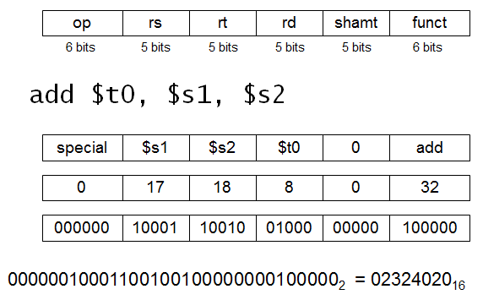
R-Format Example

Slide 32
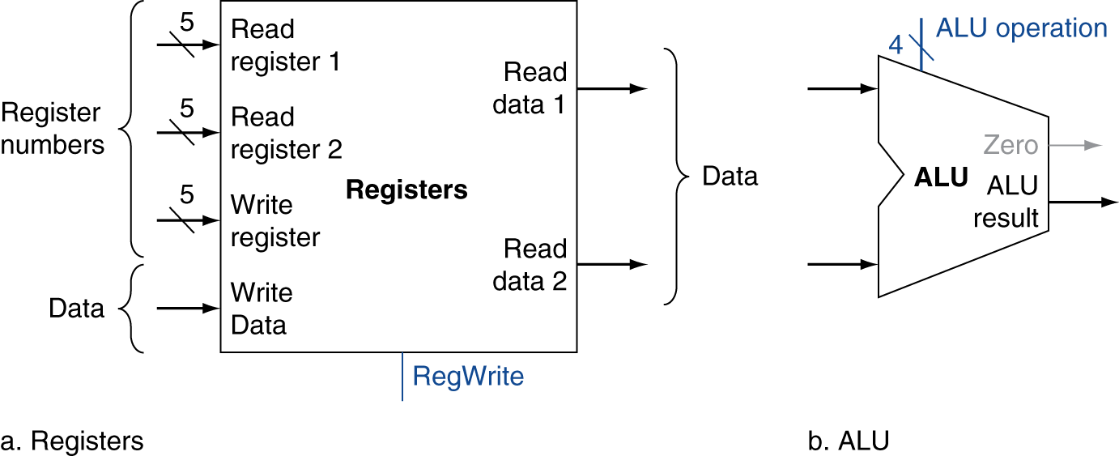
R-Format Instructions
Read two register operands
Perform arithmetic/logical operation
Write register result

Slide 33
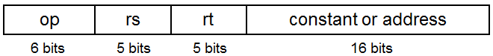
MIPS I-format Instructions
Immediate arithmetic and load/store instructions
rt: destination or source register number
Constant: –2¹⁵ to +2¹⁵ – 1
Address: offset added to base address in rs

Slide 34
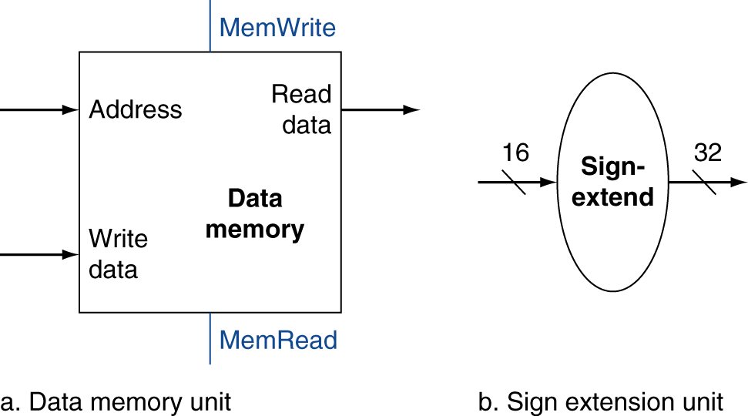
Load/Store Instructions
Read register operands
Calculate address using 16-bit offset
Use ALU, but sign-extend offset
Load: Read memory and update register
Store: Write register value to memory
lw $t1, offset($t2)
sw $t1, offset($t2)

Slide 35
Branch Instructions
Read register operands
Compare operands
Use ALU, subtract and check Zero output
Calculate target address
Sign-extend displacement
Shift left 2 places (word displacement)
Add to PC + 4
Already calculated by instruction fetch

Slide 36
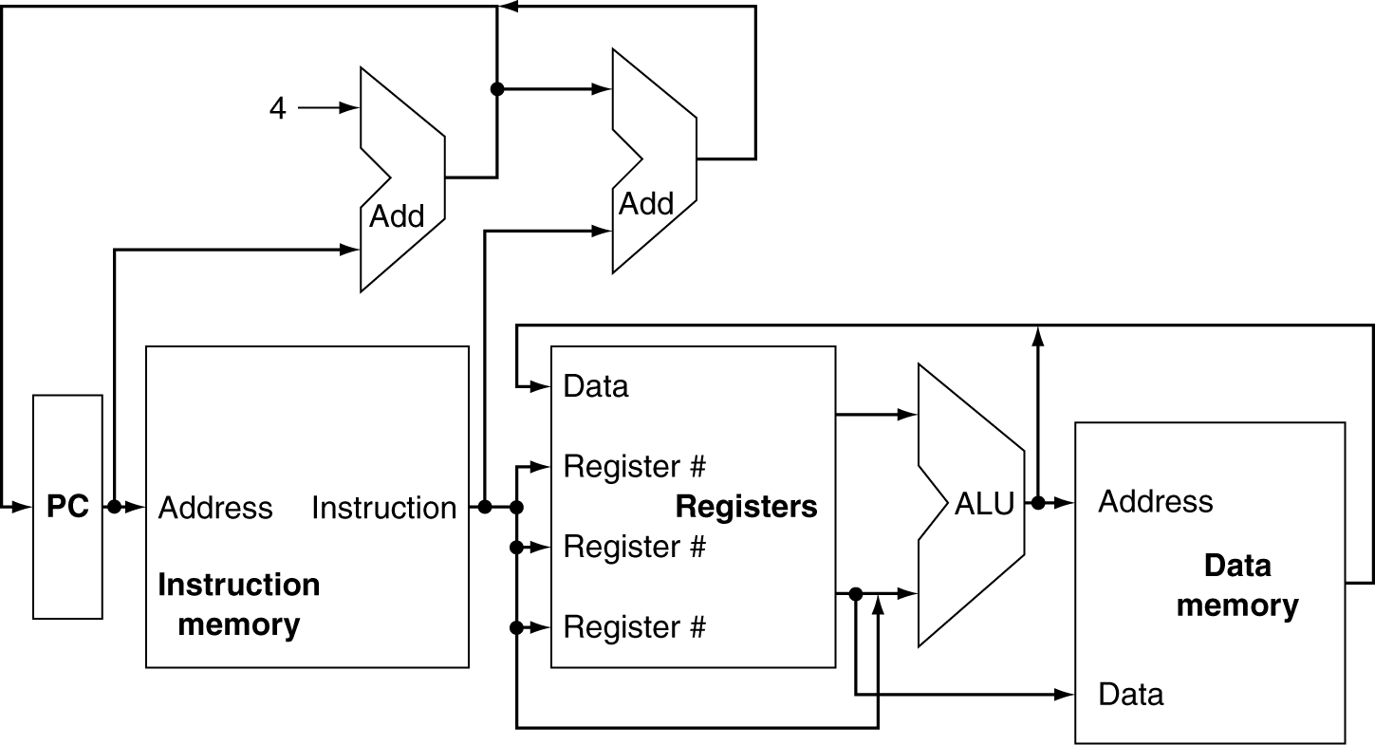
CPU Overview

Slide 37
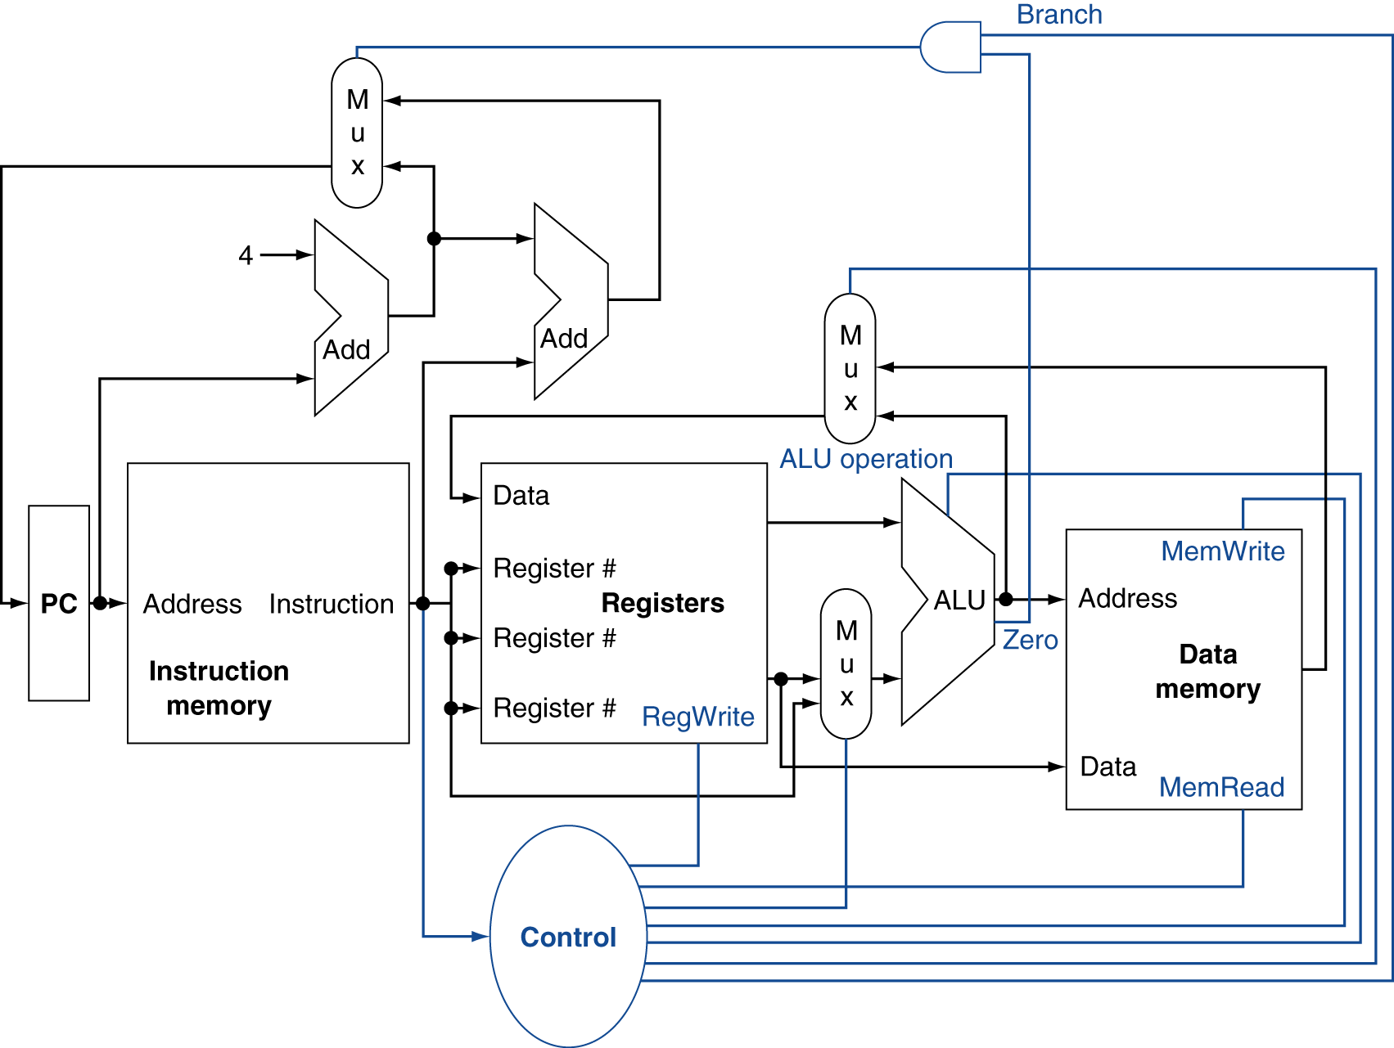
Control

Slide 38
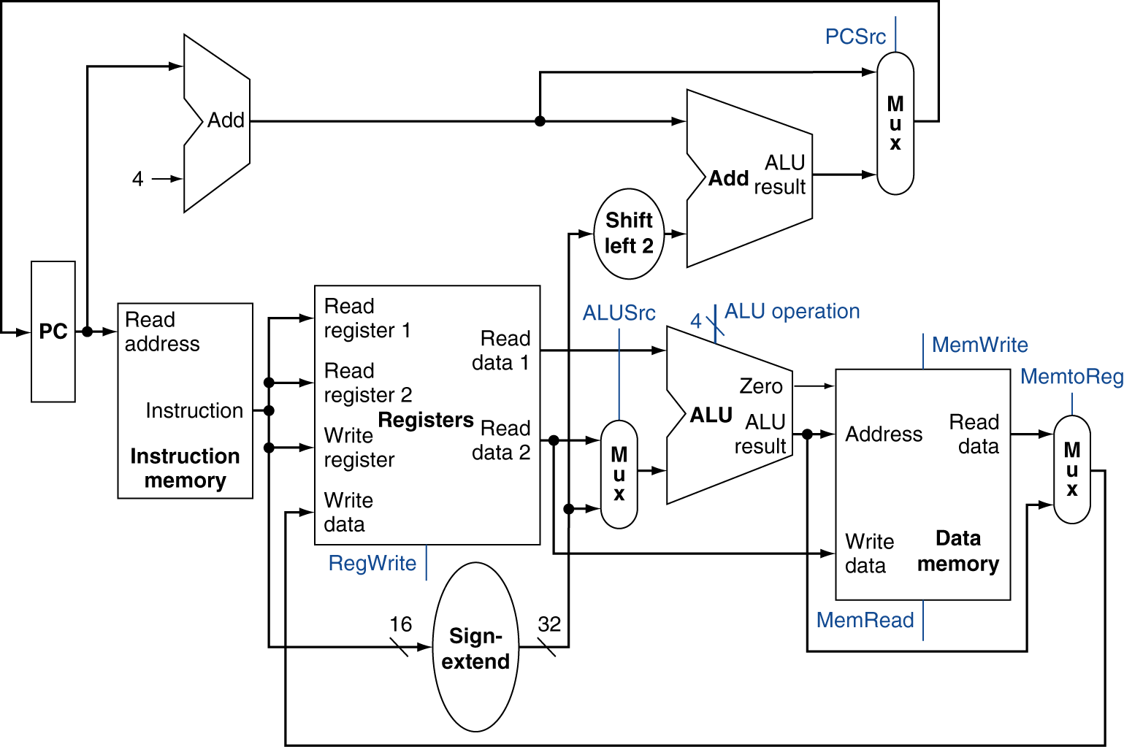
Full Datapath

Slide 39
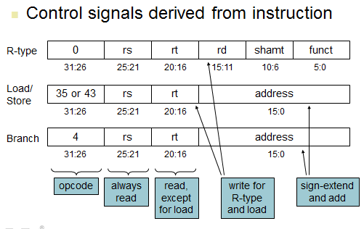
Main Control Unit

Slide 40
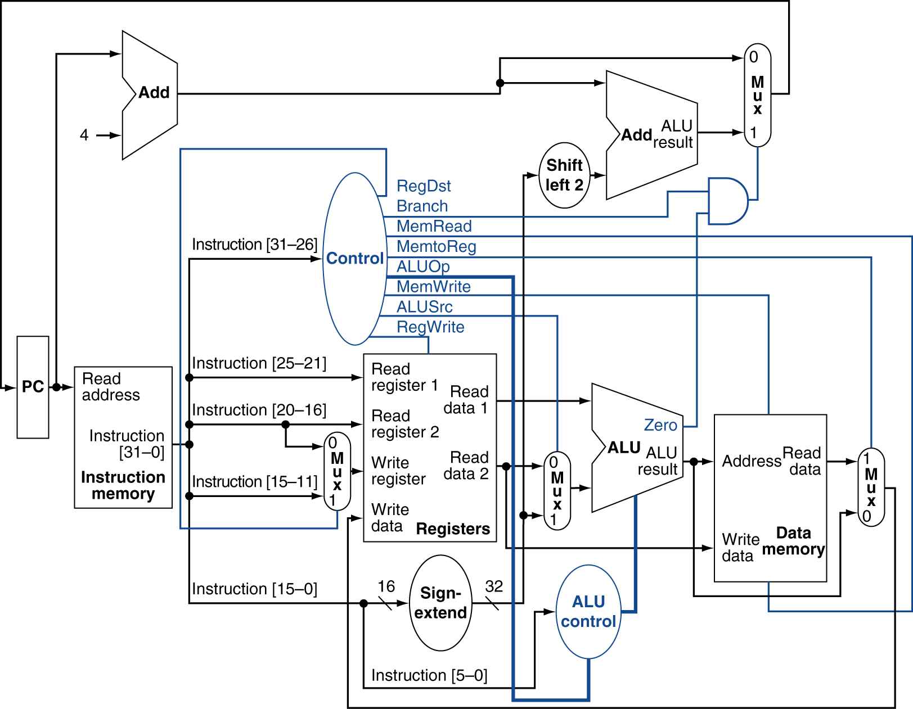
Datapath With Control

Slide 41
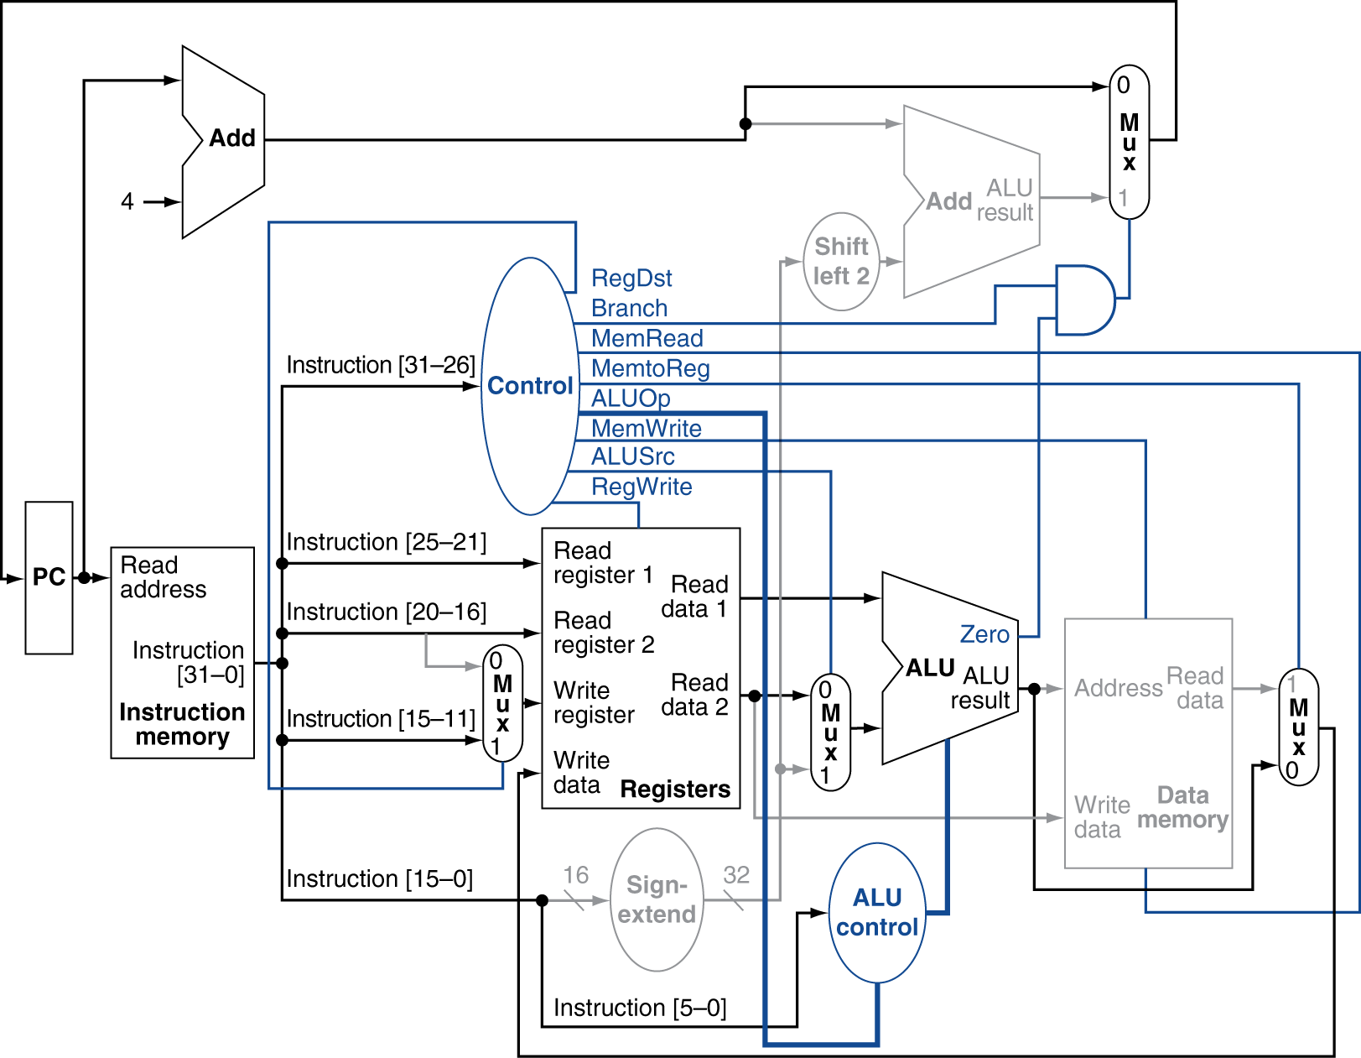
R-Type Instruction

Slide 42
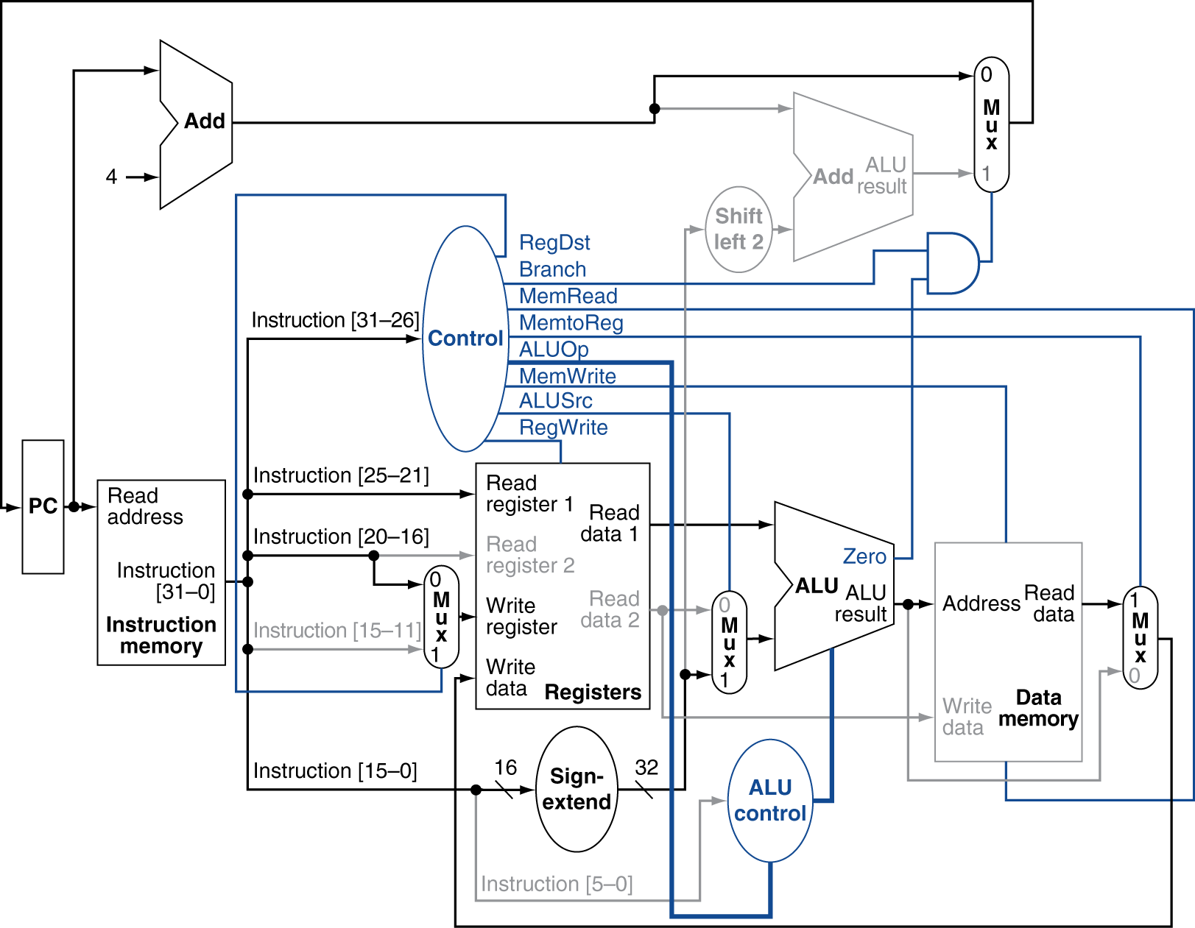
Load Instruction

Slide 43
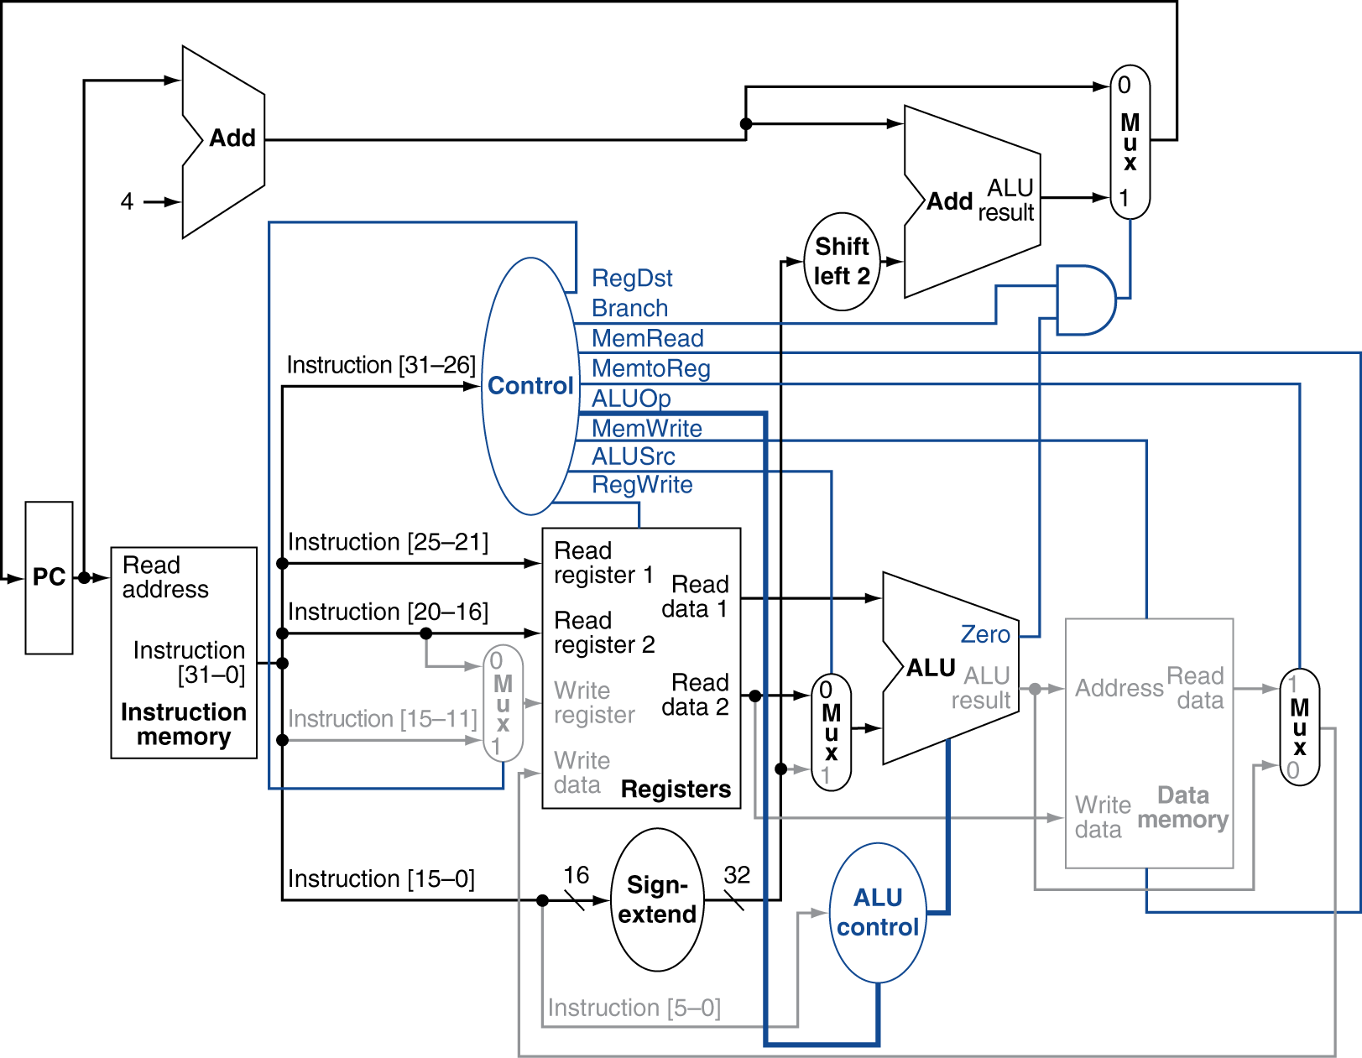
Branch-on-Equal Instruction

Slide 44
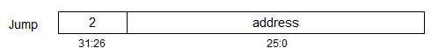
Implementing Jumps
Jump uses word address
Update PC with concatenation of
Top 4 bits of old PC
26-bit jump address
00
Need an extra control signal decoded from opcode

Slide 45
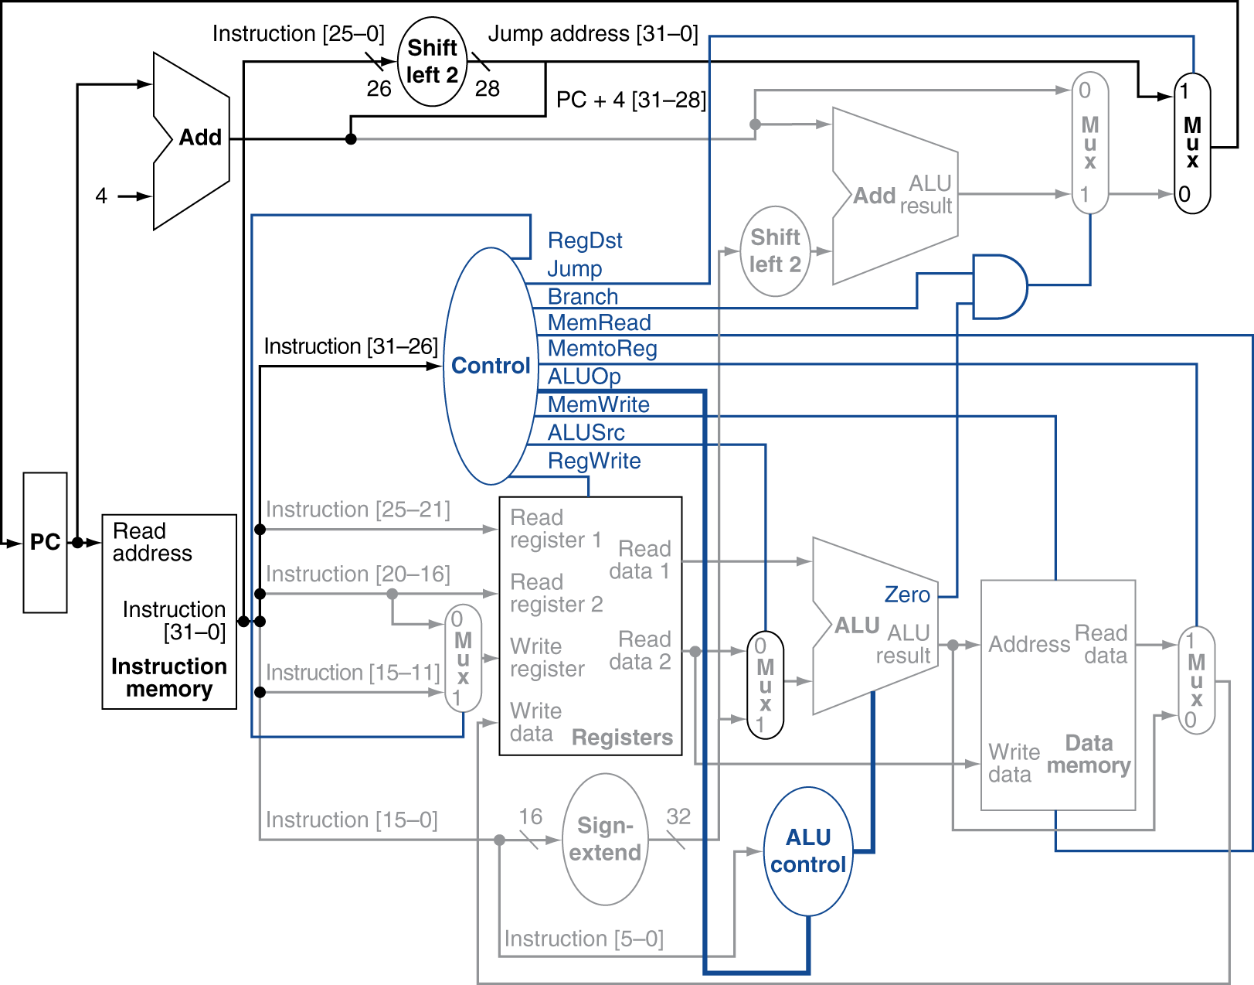
Datapath With Jumps Added

Slide 46
Performance Issues
Longest delay determines clock period
Critical path: load instruction
Instruction memory → register file → ALU → data memory → register file
Not feasible to vary period for different instructions
Violates design principle
Making the common case fast
We will improve performance by pipelining

Slide 47


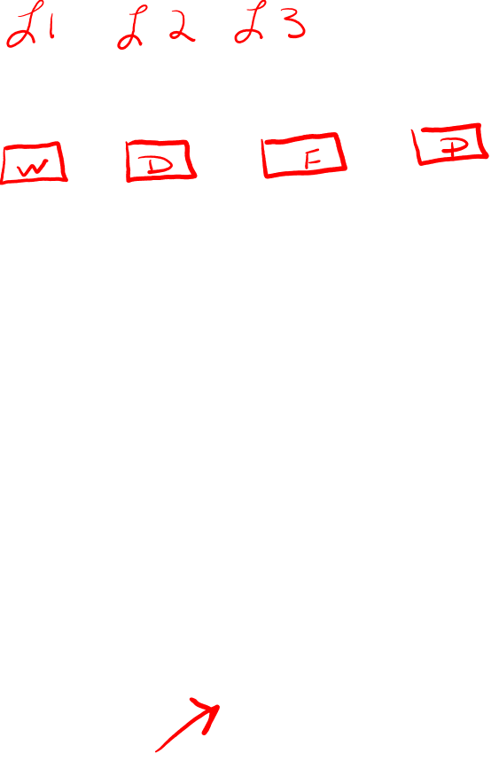

Slide 48
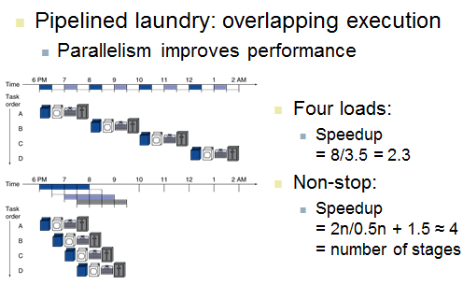
Pipelining

Slide 49
MIPS Pipeline
Five stages, one step per stage
IF: Instruction fetch from memory
ID: Instruction decode & register read
EX: Execute operation or calculate address
MEM: Access memory operand
WB: Write result back to register

Slide 50
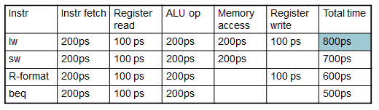
Pipeline Performance
Assume time for stages is
100ps for register read or write
200ps for other stages
Compare pipelined datapath with single-cycle datapath

Slide 51
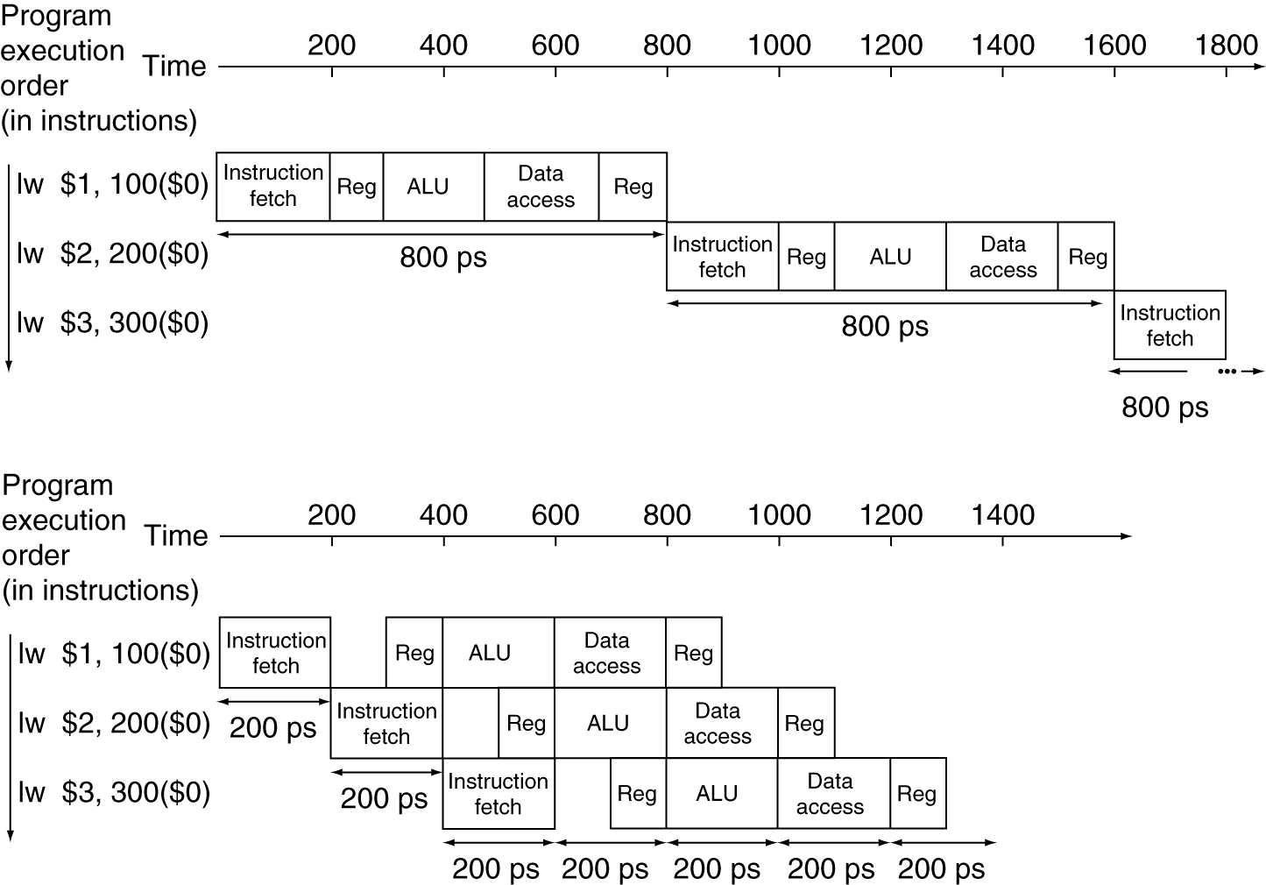
Pipeline Performance
Single-cycle (T_{c}= 800ps)
Pipelined (T_{c}= 200ps)

Slide 52
Pipeline Speedup
If all stages are balanced
i.e., all take the same time
Time between instructions_{pipelined} = Time between instructions_{nonpipelined} Number of stages
If not balanced, speedup is less
Speedup due to increased throughput
Latency (time for each instruction) does not decrease

Slide 53
Hazards
Situations that prevent starting the next instruction in the next cycle
Structure hazards
A required resource is busy
Data hazard
Need to wait for previous instruction to complete its data read/write
Control hazard
Deciding on control action depends on previous instruction

Slide 54
Structure Hazards
Conflict for use of a resource
In MIPS pipeline with a single memory
Load/store requires data access
Instruction fetch would have to stall for that cycle
Would cause a pipeline “bubble”
Hence, pipelined datapaths require separate instruction/data memories
Or separate instruction/data caches

Slide 55
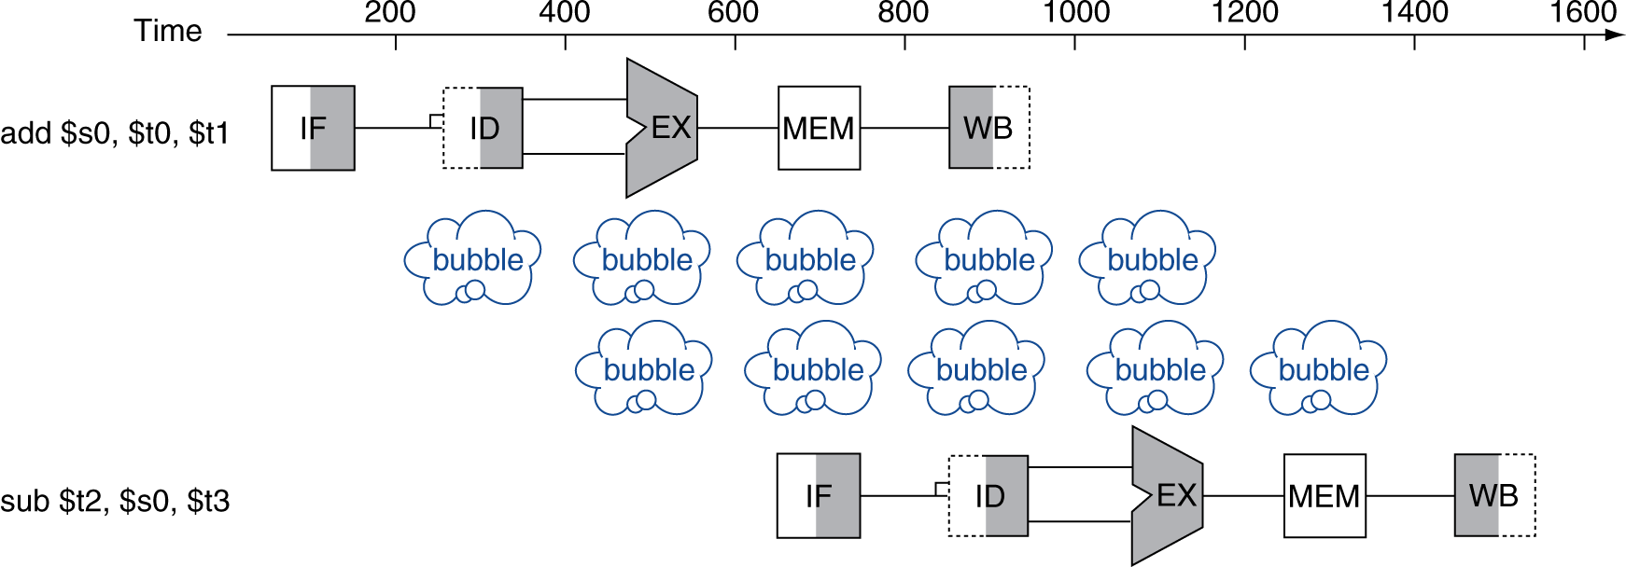
Data Hazards
An instruction depends on completion of data access by a previous instruction
add $s0, $t0, $t1 sub $t2, $s0, $t3

Slide 56
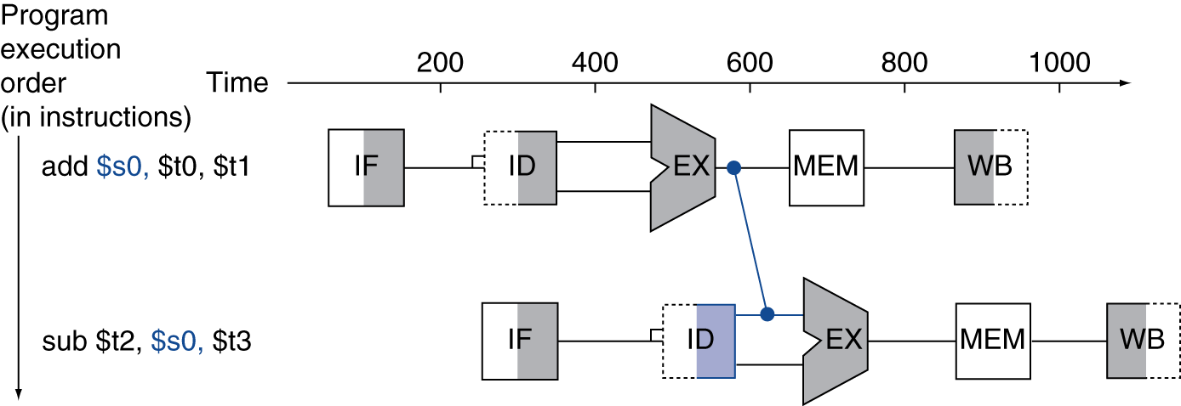
Forwarding (aka Bypassing)
Use result when it is computed
Don’t wait for it to be stored in a register
Requires extra connections in the datapath

Slide 57
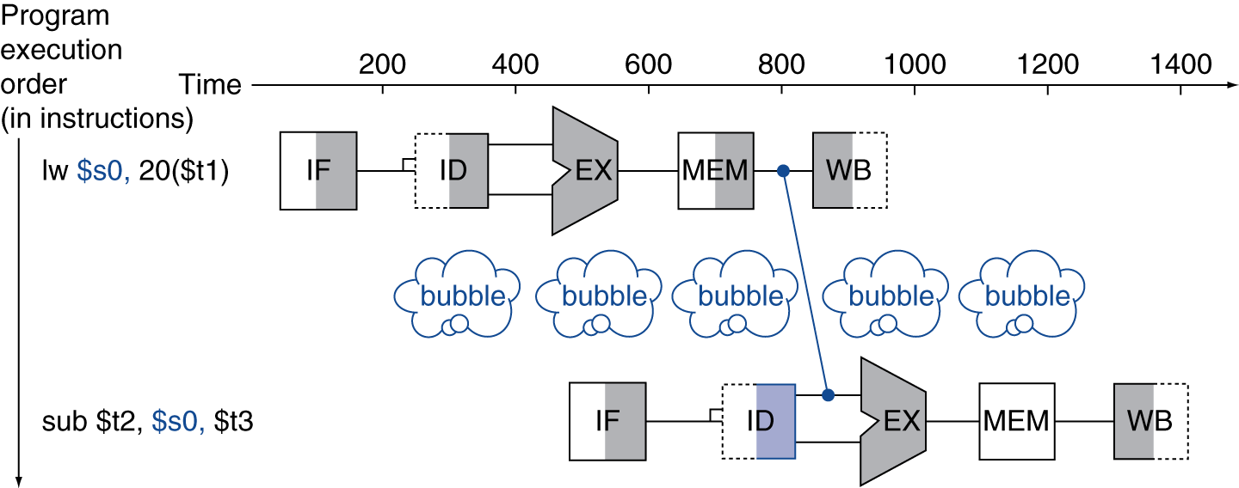
Load-Use Data Hazard
Can’t always avoid stalls by forwarding
If value not computed when needed
Can’t forward backward in time!

Slide 58
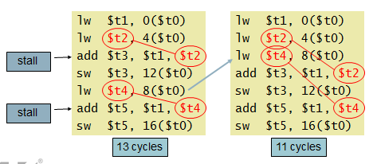
Code Scheduling to Avoid Stalls
Reorder code to avoid use of load result in the next instruction
C code for A = B + E; C = B + F;
13 cycles
11 cycles

Slide 59
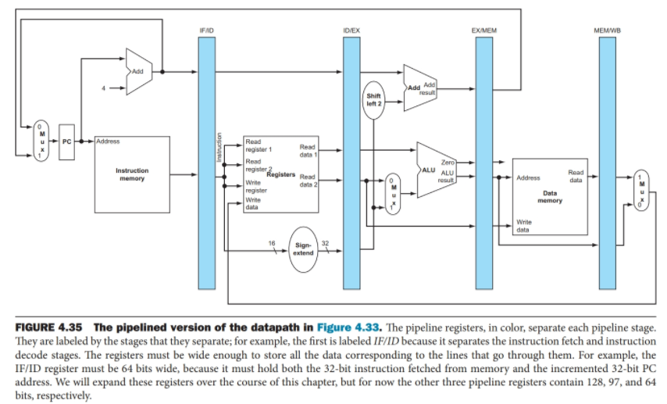
Implementing Pipeline

Slide 60
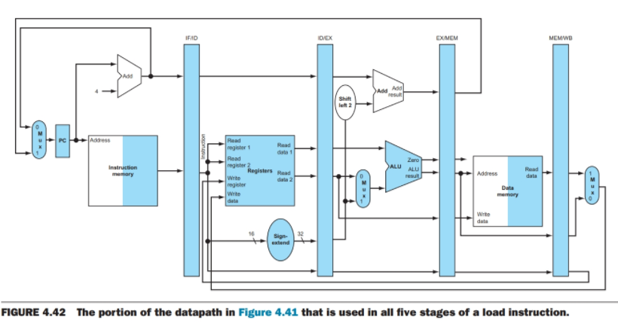
Datapath for Load

Slide 61
Control Hazards
Branch determines flow of control
Fetching next instruction depends on branch outcome
Pipeline can’t always fetch correct instruction
Still working on ID stage of branch
In MIPS pipeline
Need to compare registers and compute target early in the pipeline
Add hardware to do it in ID stage

Slide 62
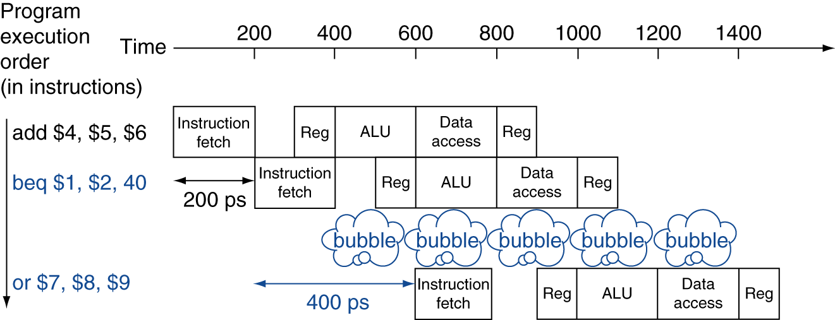
Stall on Branch
Wait until branch outcome determined before fetching next instruction

Slide 63
Assume Branch Not Taken
Predict the branch not taken and then correct the flow through the datapath in case we are wrong
Start the execution of the next instruction
Compute conditional for branch
If branch is to be taken, discard next instruction by setting controls to 0

Slide 64
Dynamic Branch Prediction
Store information pertaining to the branch – was it taken?
If it was taken last time, then assume the branch will be taken
Known as branch prediction buffer or branch history
Why is this a good scheme? Consider loops.

Slide 65
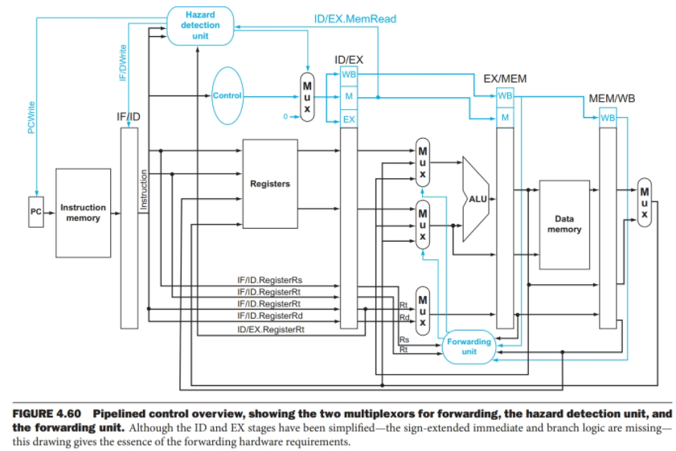
Pipeline Control

